Slide 1

Youtube and Netflix Viewership Analysis
Chau Hoang
Tanay Mukherjee

Slide 2
Background
Over 2 billion logged-in users visit YouTube each month, and every day people watch over a billion hours of video and generate billions of views (2017)
“If you were to sit and watch a billion hours of YouTube, it would take you over 100,000 years” - YouTube’s VP of Engineering
Netflix users spent a combined 164 million hours per day watching content in 2019

Slide 3
Goal/Purpose
We want to analyze YouTube trending videos statistics in 10 different countries and compare with Netflix data to learn more about different trends and topics that people from different parts of the world are interested in at the same time frame.
Business Value
This analysis can be used to extend possible collaboration with Ad agencies to help them figure out what kind of videos might bring more traction to their Product Ads for future campaign strategy. How can OTT platforms like Netflix make benefits out of it?

Slide 4
Other Use Cases
Audiences/ stakeholders can use this analysis to
understand the content that are popular amongst viewers in different countries
identify the patterns and compare the audience viewership of a particular show on Netflix v/s what they consume on free content platforms like YouTube.
It also helps producers for particular shows on Netflix to partner with channel owners on YouTube for promotion of their upcoming shows.

Slide 5


KPIs
Total views by category
Top channels with most trending videos
With filters for categories
Interactions by video views
Likes and dislikes per view
Grouped by category
Total Likes and Total Dislikes by Geo
YoY Comparison [2017 vs 2018] of key metrics by category
Comment count
Total Likes
Total Dislikes
Total Views
Total Likes and Total Dislikes by Year & Month
Content heatmap for Netflix by Year & Month
Total records in Netflix by Geo

Slide 6
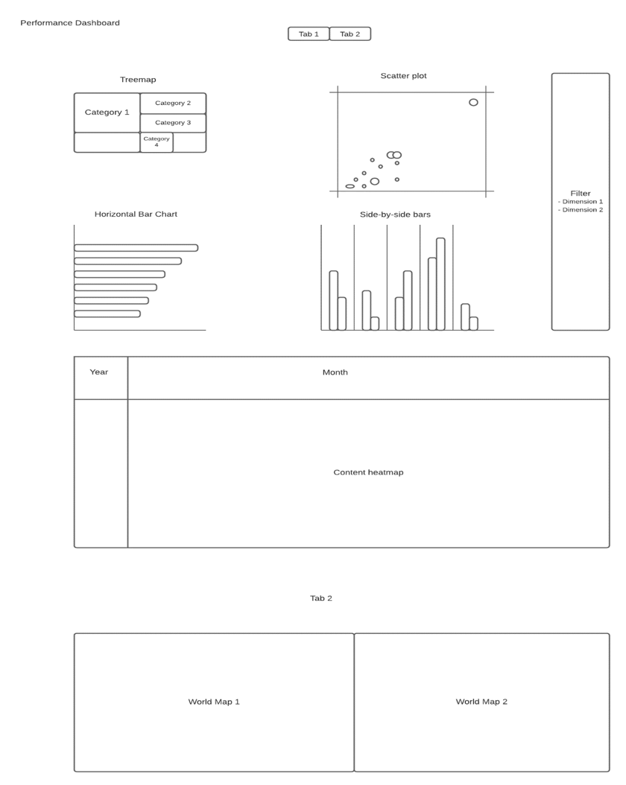
Tableau Dashboard
Link: here

